Slide 1

AUSTRALIA’S SYSTEM OF GOVERNMENT
Chapter 2

Slide 2
SYLLABUS DOT POINT (examinable material)
Structure of political and legal system in Australia
Key terminology: division of powers, responsible government, constitutionalism, federalism, judicial independence

Slide 3
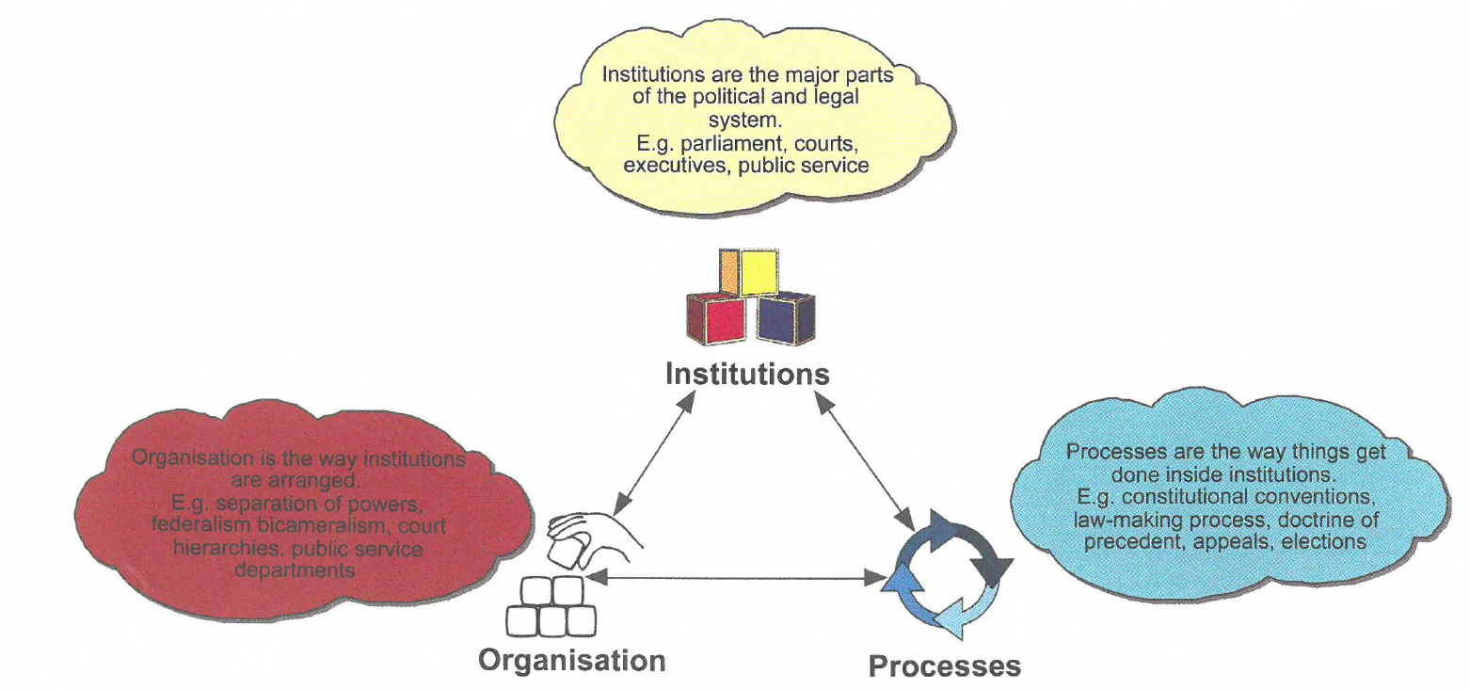
Key characteristics of a liberal democracy

Slide 4
REPRESENTATIVE GOVERNMENT
Read page 21-22
Refers to a government which represents the views of the majority of the people
Consists of representatives of the people – chosen by the people = DEMOCRACY
To achieve this there must be regular elections
If the government does not represent the needs of the majority of the people, it is likely to be voted out of office at the next election
The principle is established in the Constitution, which requires the members of the Senate and the House of Representatives to be chosen directly by the people (s. 7 & s. 24)
For a government to be representative, it MUST be answerable to the people
Question: How does a bicameral system contribute towards a more representative government?

Slide 5
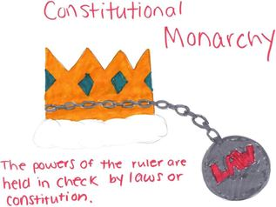
CONSTITUTIONAL MONARCHY

Slide 6
CONSTITUTIONALISM
Read page 23
Definition:
Constitutionalism is the belief that the powers of government should be limited and subject to the rule of law. Constitutionalism requires that the powers of the parliament must be set out in a written or unwritten constitution.
Sports clubs to public companies – almost all of these bodies have constitutions that set out the membership rules and the decision-making processes that govern the organization or club
A political constitution is a set of fundamental laws that ‘governs the governors’
Constitutions define the powers of government (limits the government – creates boundaries), the structure of the political system, and the processes and procedures of government. They set out the legal way in which power can be exercised in a political system
Note: Constitutions are difficult to amend

Slide 7
Responsible government
Read page 24 (bottom right) to top of page 26
Refers to the government's responsibility to the voters. A democratically elected government must be answerable and accountable to the people for its actions
Ministers are drawn from within the government (s.64) and they must maintain the confidence of the government
Note: the Senate is able to scrutinize bills before they are passed and become law. This helps to ensure the government is being accountable to the people

Slide 8
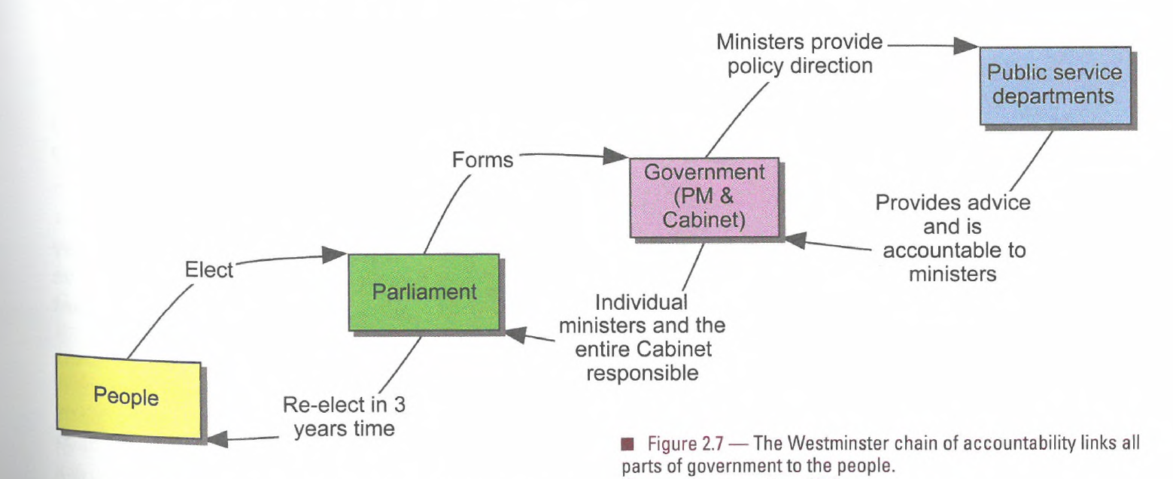

Slide 9
RESPONSIBLE GOVERNMENT
The principles of a responsible government are:
Ministers are responsible to parliament and therefore to the people – a minister can be called to explain in parliament his or her actions and those of the department and agencies under his or her control = ministerial accountability
Example: Michaela Cash and her leaking adviser illustrates a failure of ministerial responsibility. Her office’s role in tipping off media to police raids on union offices
Members of parliament have the opportunity to question ministers about their activities and the activities of their department (Question Time)
Minister must carry out their duties with integrity and propriety or resign
There are opportunities for public scrutiny of the law-making process so the public can hold the government accountable or its actions; the government must respond to concerns/answer questions where appropriate
A record of parliamentary proceedings is kept in Hansard which is available to the public, and the public can view parliament in operation
If the government loses the support of the lower house it must resign (no confidence motion)

Slide 10
